Slide 1
Subversion
Open source version control

Slide 2
Why version control?
If more than one developer is working on a project - how can they all make changes to the source code...
How can one developer be sure they have the latest versions of another developers files?
How can a developer be sure when they overwrite a file that they aren't losing someone else's changes?
Version control solves these problems by managing versions of source code files - i.e. every change gets a revision number

Slide 3
Why version control?
Version control also gives us a history of a software project
If we accidently delete some code, we can look for an older version that still has the code
We can see who made what changes
Serves as a backup

Slide 4

History
Source Code Control System (SCCS): the first version control software developed by Bell Labs in 1972 for UNIX systems
Revision Control System (RCS): developed in the 80s as a free and evolved alternative
Concurrent Version System (CVS): based on RCS, it added better project management and branching
Subversion (SVN): started in 2000 to fix bugs and add features to CVS

Slide 5

Terminology
Repository: a storage location for projects that SVN will manage
Checkout: to download a copy of a project from a repository
Commit: to upload files to a repository after making changes
Update: to download the latest versions of files from a repository when your local copies are out of date

Slide 6

Repositories and projects
SVN stores projects in a repository
However a project is just a folder in a repository, like all the other folders, e.g.
For example: http://svn.openmrs.org/
MyRepos\
MyProject\
Foo.java
Bar.java
SomeOtherProjects\
AnotherProject\
Main.java

Slide 7
Revisions
MyRepos
MyProject
Foo.java
Bar.java
1
Initial commit
of the 2 files
public class Foo {
}
public class Bar {
}
2
Commit after
changing Foo.java
public class Foo {
int val = 0;
}
public class Bar {
}
3
Commit after
changing Bar.java
public class Foo {
int val = 0;
}
public class Bar {
void foo() {}
}
4
Commit after
changing both
public class Foo {
float val = 0;
}
public class Bar {
void foo() {
// TODO
}
}

Slide 8
Committing and Updating
If more than one developer is working on a project then they should update their local copy before making changes
1
2
3
Initial
commit
Checkout
Commit
Update
Commit

Slide 9
Update
It's possible for more than one developer to have files checked out at the same time
What if they both make changes to the same file?
1
2
3
Initial
commit
Checkout
Commit
Commit
Returns error: repos out of date

Slide 10
Update
SVN returns an error because the repository is at revision 2, but the client is checking in with revision 1
Client must update before they can commit
1
2
3
Initial
commit
Checkout
Commit
Update
Commit
Changes have to be merged

Slide 11
Merging changes
Updating won't lose the changes you've made locally
The changes in the latest revision are merged with the changes in your local copy
This merging process is done automatically and produces a file which needs fixed by the developer

Slide 12
Example
1
Checkout
Checkout
public class Foo {
}
public class Foo {
}
public class Foo {
int value = 0;
}
public class Foo {
void bar() {}
}
Commit
2
Error
Commit

Slide 13
public class Foo {
int value = 0;
}
public class Foo {
void bar() {}
}
Commit
2
Update
public class Foo {
<<<<<<< .mine
void bar() {}
=======
int value = 0;
>>>>>>> .r4
}
svnmerge tool creates a
version of the file with
both sets of changes
svnmerge
developer then manually
merges the changes into
a new working version
public class Foo {
void bar() {}
int value = 0;
}
3
Commit

Slide 14
Commit comments
Every commit has a comment which should tell other developers very briefly what has changed
Because a commit can only have one comment for all the files being committed, it is often necessary to commit files individually or in smaller groups

Slide 15

Project structure
Projects within a repository are usually organized into trunk, branches and tags
Trunk is the main code base of the project

Slide 16
Tags
A tag is a snapshot of a project at a specific revision
Allows us to give a meaningful name to a revision, e.g. "OpenMRS 1.4"
1
2
3
5
6
8
Trunk
4
7
"OpenMRS 1.4"
"OpenMRS 1.5 BETA"

Slide 17
Branches
Unlike a tag, a branch is a copy which will be modified
Allows changes to be made in parallel to the originating branch, which is usually the trunk
1
2
3
5
8
Trunk
4
6
7
"OpenMRS 1.5 TURBO"

Slide 18
Merging
Branches can be merged
Often features added to a branch will be merged into the trunk
A branch that won't be merged back into the trunk is called a fork
1
2
3
5
7
8
Trunk
4
6
"OpenMRS 1.5 TURBO"

Slide 19
Repository access
SVN supports several different access methods:
Filesystem
Local e.g. file:///path/to/repos
Remote e.g. file://host/path/to/repos
HTTP - using WebDAV with Apache 2
HTTP e.g. http://host/url/to/repos
HTTPS e.g. https://host/url/to/repos
SVN protocol
Unencrypted e.g. svn://host/url/to/repos
With SSH e.g. svn+ssh://host/url/to/repos

Slide 20
Creating a respository
Create a directory to hold the repository
Use svnadmin to initialize it
For example: creating a
repository in a Linux home
directory...
> cd ~
> mkdir svn
> svnadmin create svn
Repository can now be
accessed using the file
protocol...
file://<host>/<path>/svn

Slide 21
Clients
SVN has its own set of command line tools for client access, e.g.
svn co file://intare/svn/myproject
However several graphical clients exist which are easier to use
TortoiseSVN (Windows only)
Subclipse (plugin for Eclipse)
SmartSVN (written in Java)
RapidSVN

Slide 22
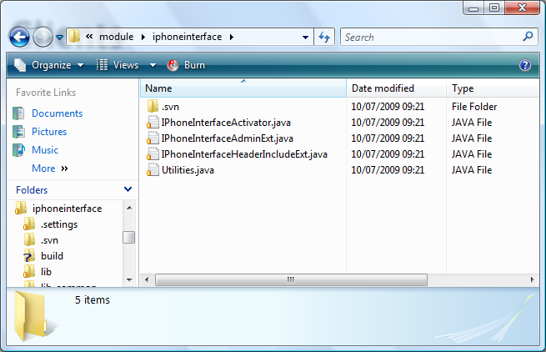
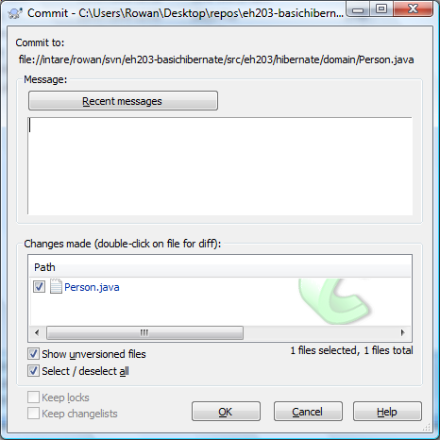
Clients: TortoiseSVN
This is a popular client for Windows because it integrates with Explorer

Slide 23
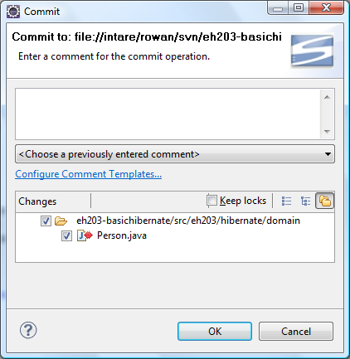
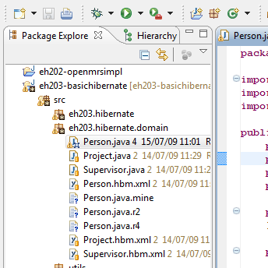
Clients: Subclipse
This is a plugin for Eclipse

Slide 24
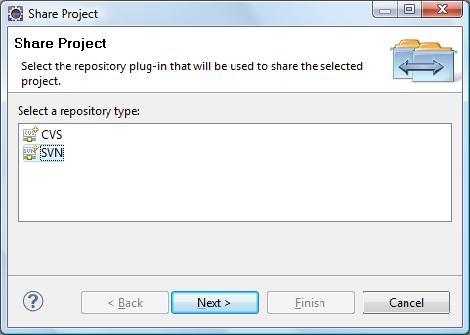
Subclipse: exporting to SVN
Right-click on the project to be shared, and select Team → Share Project
Select SVN as the repository type

Slide 25
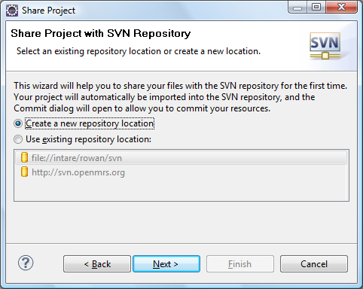
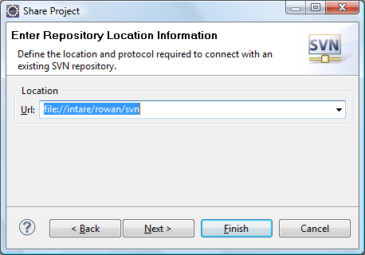
Subclipse: exporting to SVN
If you do not have an existing repository configured, create a new one...

Slide 26
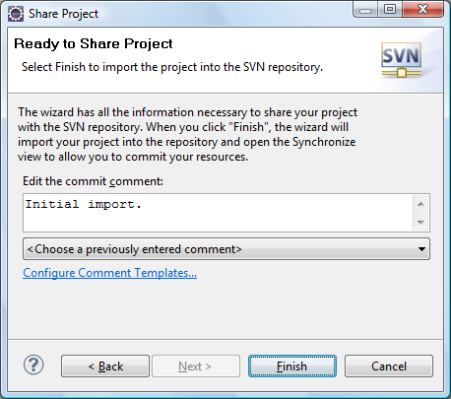
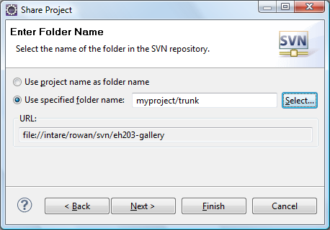
Subclipse: exporting to SVN
Specify the path for the project, and a commit comment. Then finish!

Slide 27
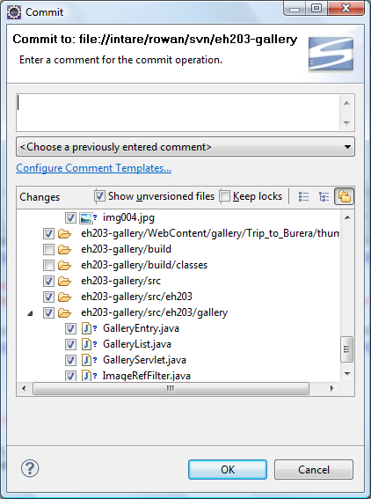
Subclipse: exporting to SVN
The initial import only creates the project folder in the repository
Go to Team → Commit...
Uncheck the files such as the build directory that should not be added to the repository

Slide 28
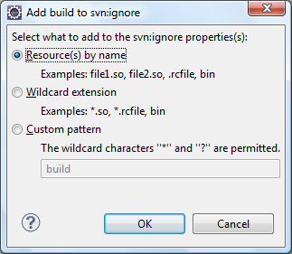
Subclipse: exporting to SVN
To prevent Subclipse from trying to commit files such as the build directory in future:
Right-click on them and select Team → Add to svn:ignore
This will require another commit

Slide 29












Subclipse: icon key
Normal - not changed since last commit
Modified - changed since last commit
Added - added since last commit
Deleted - deleted since last commit
Non-versioned - not under version control
Ignored - has been added to svn:ignore

Slide 30
References
Websites
http://subversion.tigris.org/
http://en.wikipedia.org/wiki/Subversion_(software)

